Slide 1
Zero Waste Zero Hunger
By Jayashree Patel
Group name – javaIsFun
NU ID - 001378716

Slide 2

Problem Statement
Each year billions of pounds of food go to waste, while 1 in 4 people are malnourished.
In the United States, 63 million tons of food are wasted every year. Food waste accounts for 21 percent of all fresh water used in the United States and takes up 21 percent of landfill volume. Waste happens at every stage of the supply chain between farm and table.
Food is wasted at the farm due to overproduction, market fluctuations and strict aesthetic food industry requirements. Food is damaged or lost as it is packaged and shipped. More food spoils in overstocked retail outlets and home refrigerators.
Some restaurants/cafés have a policy to not serve food from previous day, despite being perfectly edible. This is all thrown away as “waste”, at the end of day.
At the same time, worldwide nearly 800 million people do not have enough to eat. That means one in nine people are suffering from hunger. Hunger and malnutrition are the number one risk to health worldwide. (ref: https://www.foodbanking.org/hunger-food-banking/about-hunger/global-hunger)

Slide 3
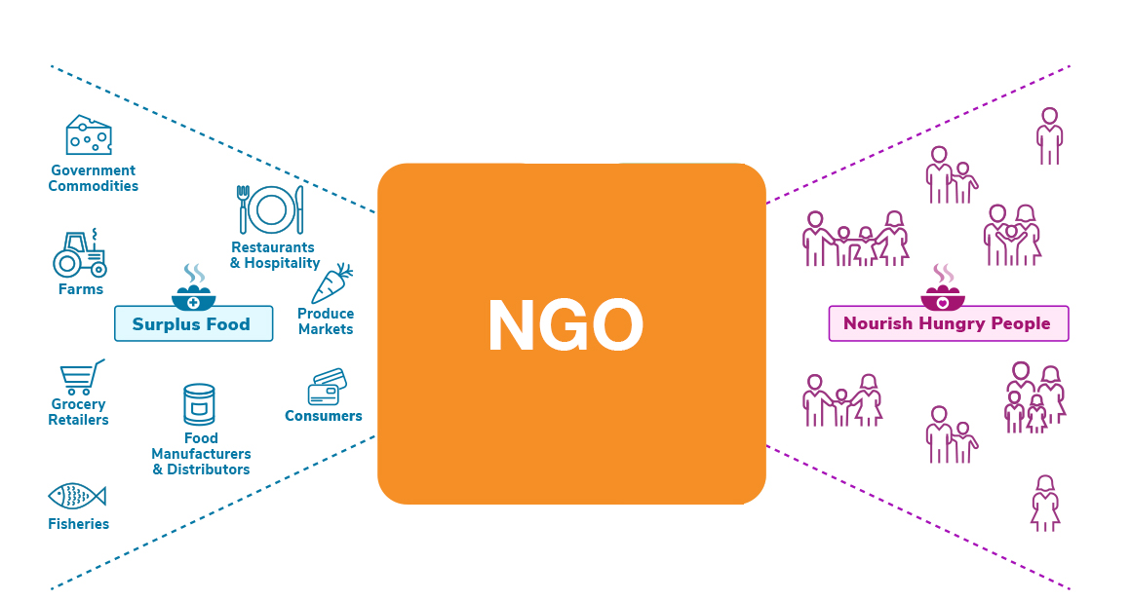
Solution
This application provides a way to bridge the gap between the wastage and deficit, by letting donors donate this food to NGOs, who in turn can feed the needy

Slide 4
Approach
This application helps to reduce wastage and feed hungry people by bridging the gap with the help of NGO
There are different enterprises like Donor, Delivery, NGO, Authority who are working together to achieve this goal
First, donor raises a pickup request which the donor manager checks and sends it to NGO manager
NGO manager then forwards the request to delivery manager and delivery manager assigns it to his delivery staff (Only available staff)
The Delivery Staff picks up the excess food from donor and delivers it to NGO staff
NGO staff collects the food parcel and sends it to NGO testing department for checking the quality of food
NGO testing departments check if the food is in good condition and also mentions its expiry date and storage conditions
If the food is not in good condition, testing department puts it in waste inventory else in edible inventory
NGO staff checks edible inventory and distributes food to the hungry. If the food in edible inventory has expired it is moved to waste inventory again
Mayor can see statistics like which donor avoided how much wastage and which NGO fed how many people.

Slide 5
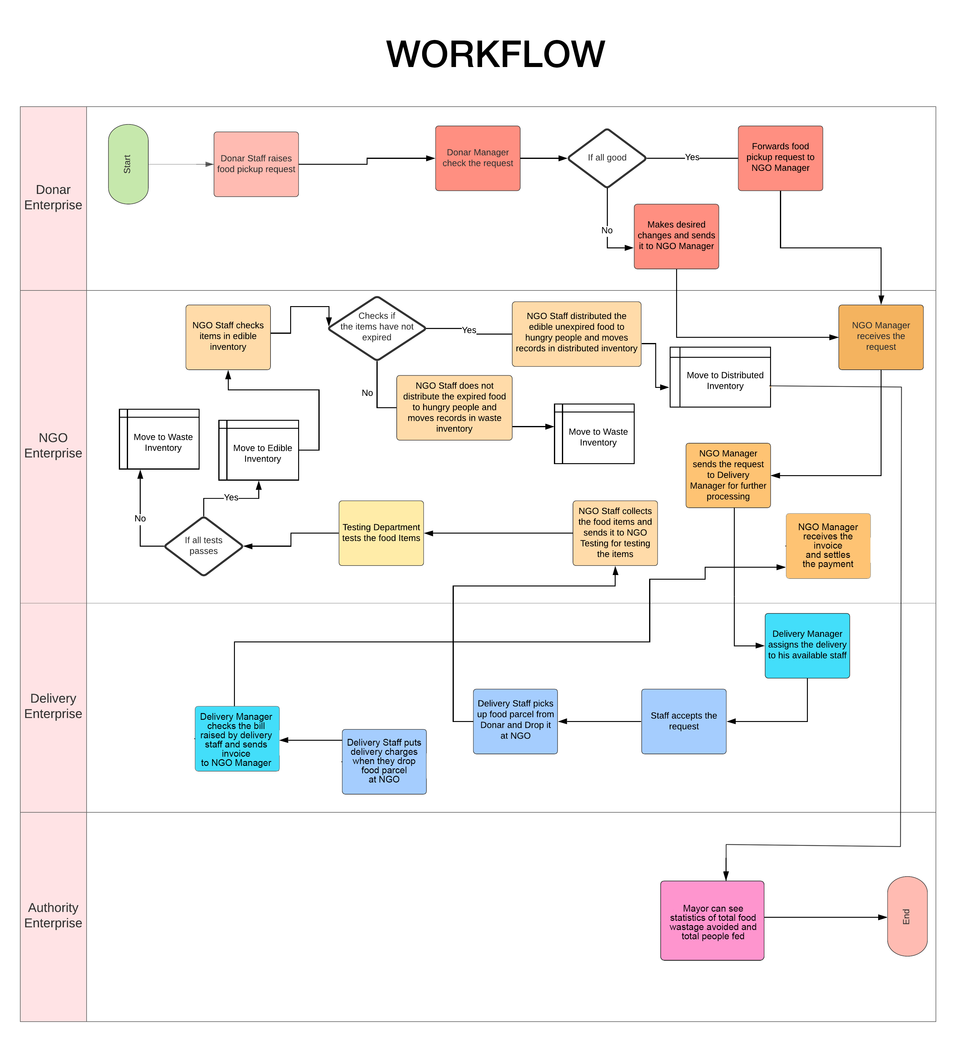

Slide 6
OBJECT DIAGRAM

Slide 7
Use Case 1 – Pickup Request
Donor staff creates a food pickup request for extra food, which is sent to Donor Manager for his approval
Donor Manager checks the food items in the request, if all is good, he approves the request and send it to NGO Enterprise Managers within the network for collecting the food parcel
NGO Manager gets the request and forwards it to the Delivery Enterprise present within the network for Picking up the parcel from Donor and Dropping it at NGO

Slide 8
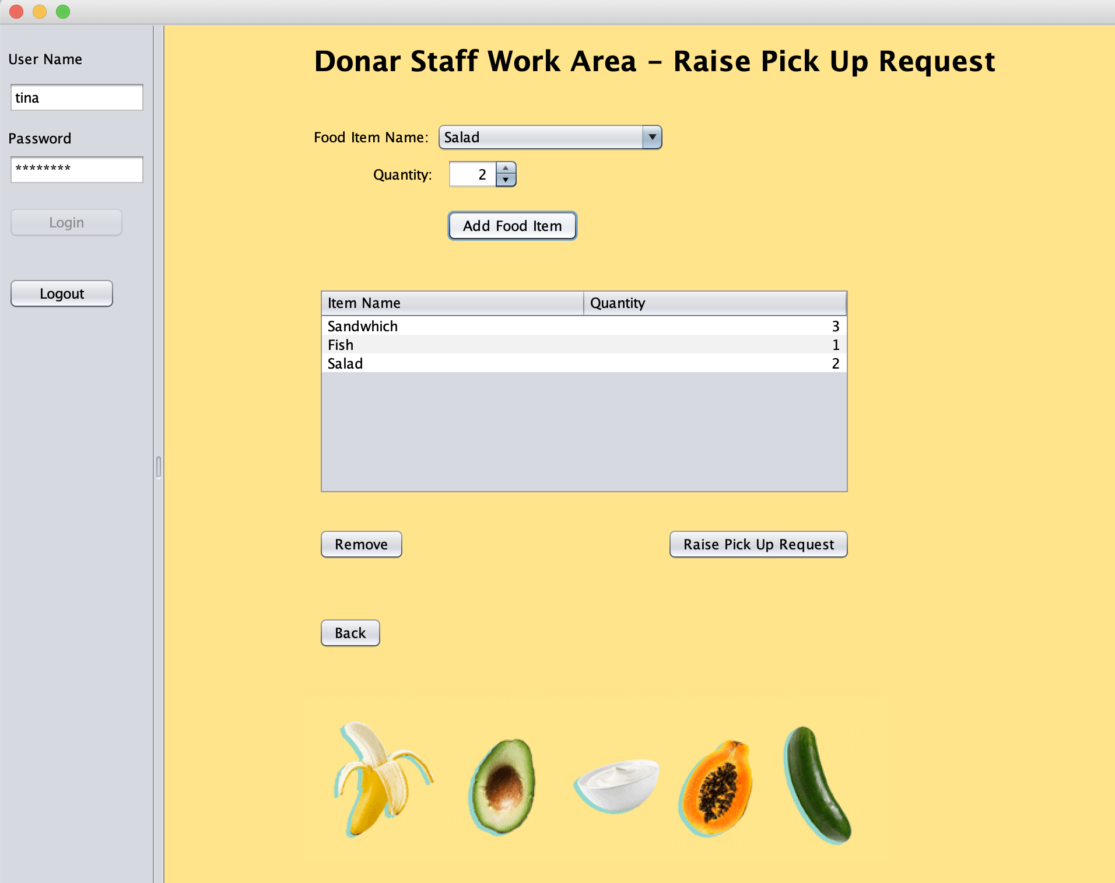

Slide 9
Use Case 2 – Delivery Request
Delivery Manager receives the delivery request from NGO Manager
Delivery Manager assigns the delivery to his staff(only available staff can be assigned)
Delivery Staff checks and request and picks up food items from Donar and Drops it at NGO (NGO staff)

Slide 10
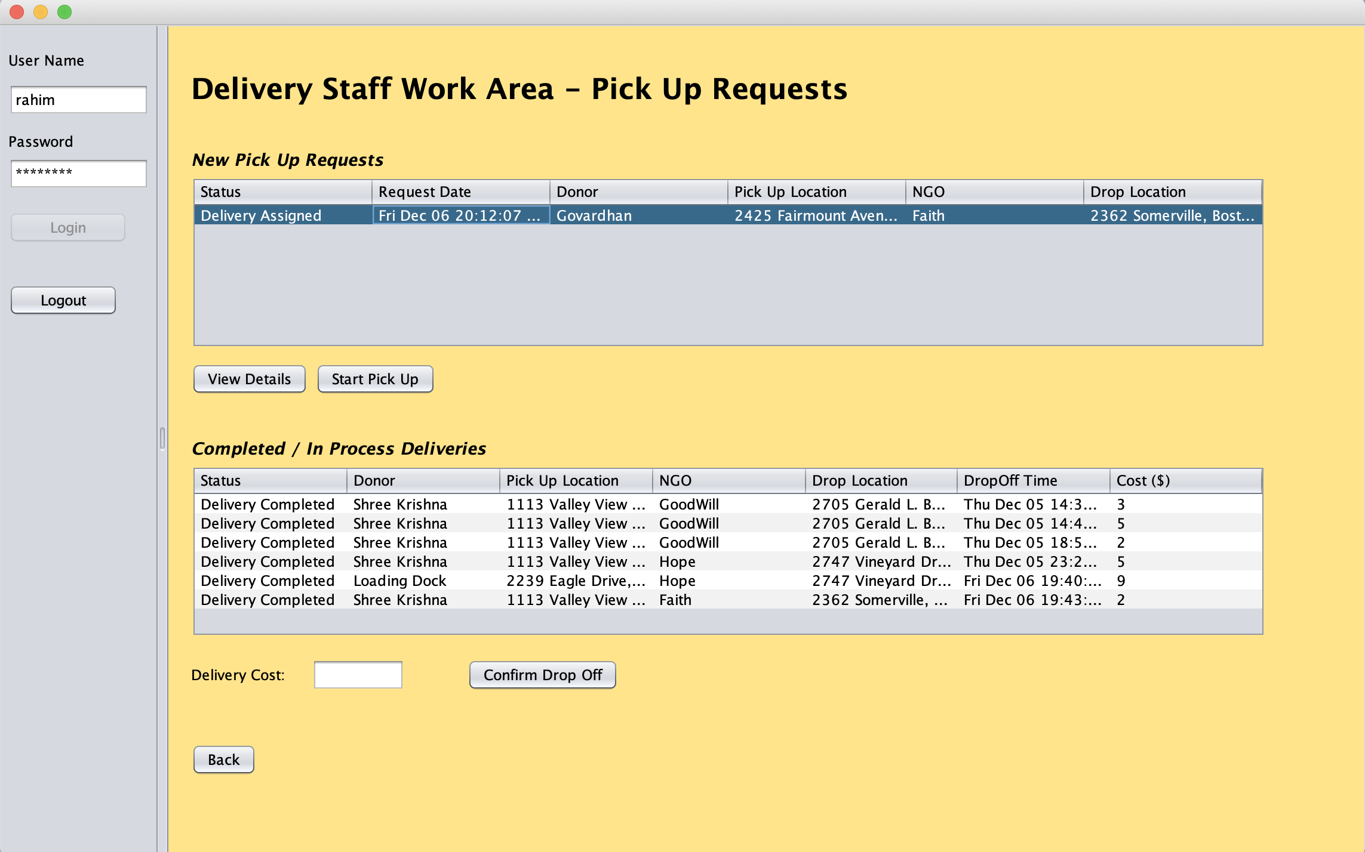

Slide 11
Use Case 3 – Collection Request
NGO Staff collects the delivery from delivery staff and sends it to testing department for testing the food items received

Slide 12
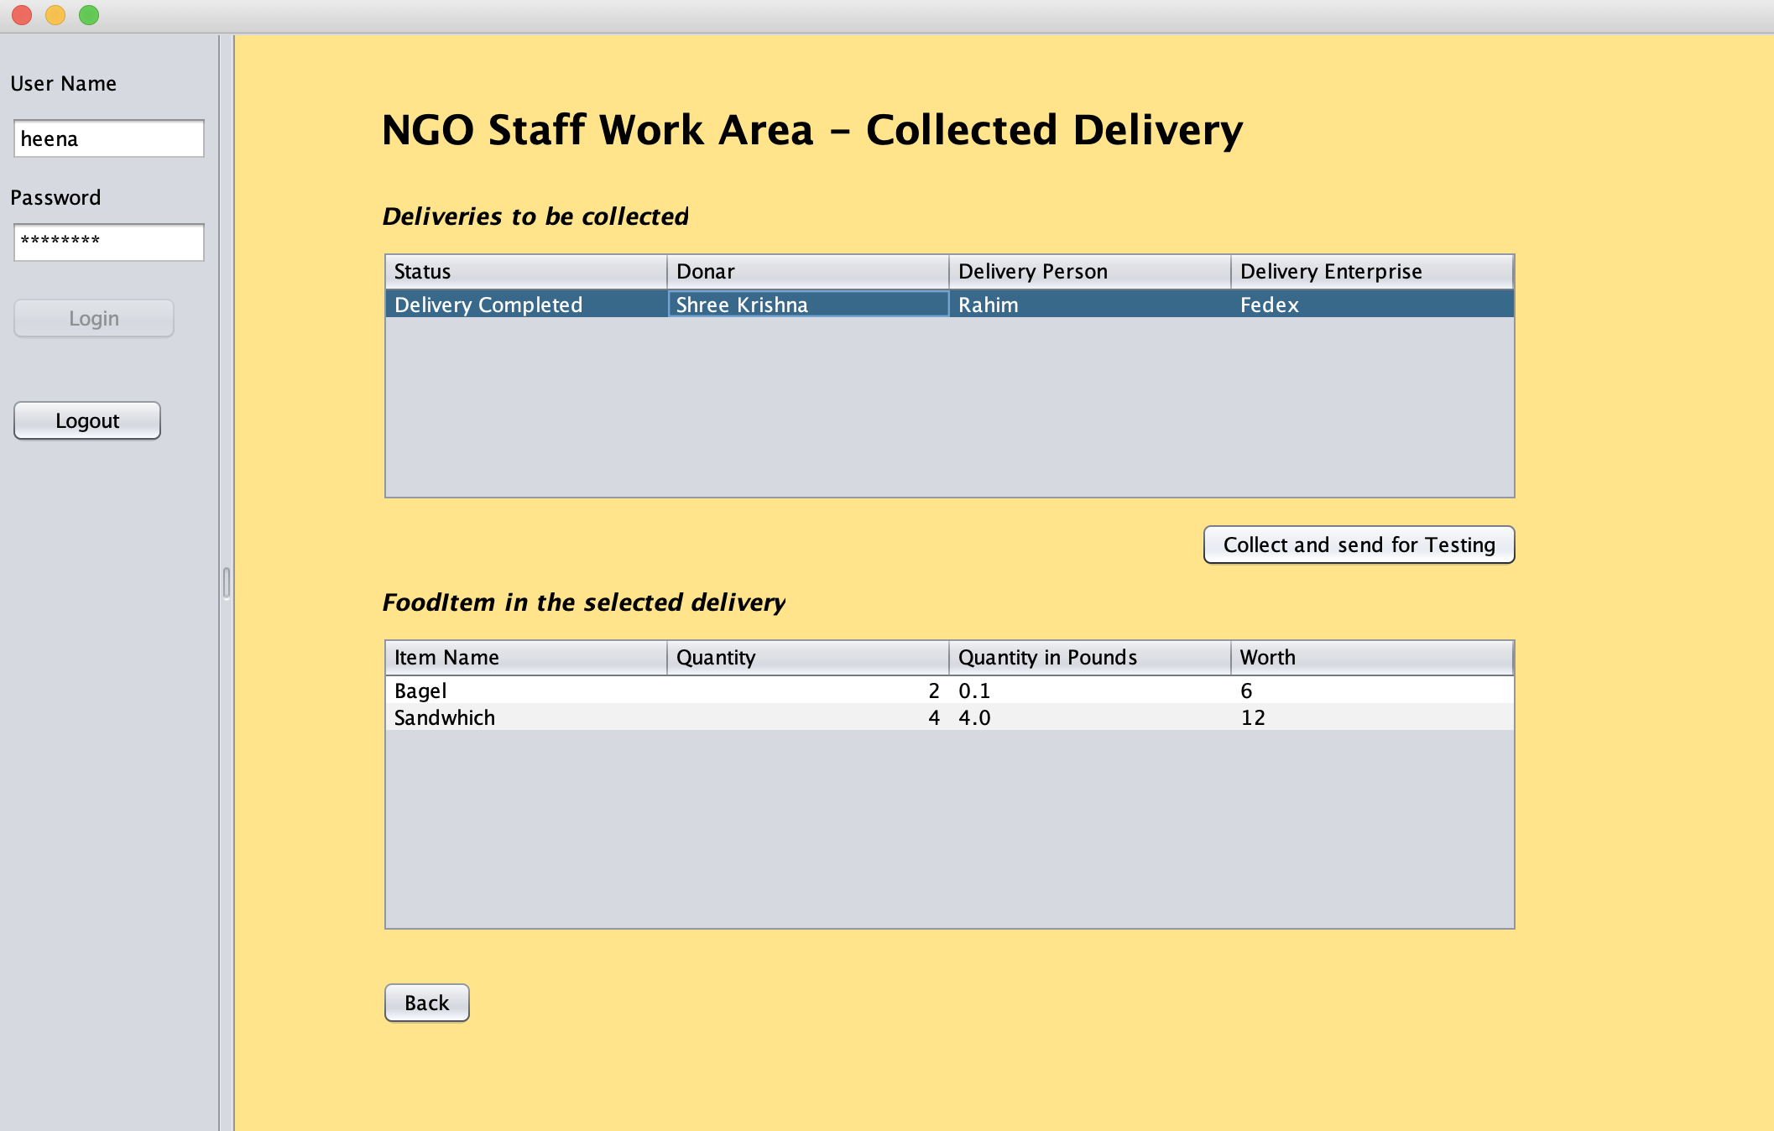

Slide 13
Use Case 4 – Testing Request
Testing department receives the testing request which contains food items
Testing department checks the food items and if they pass all test, they put storage conditions and expiry date on the parcel and puts it in edible inventory
If food items fail the test, testing department sends it to waste inventory

Slide 14
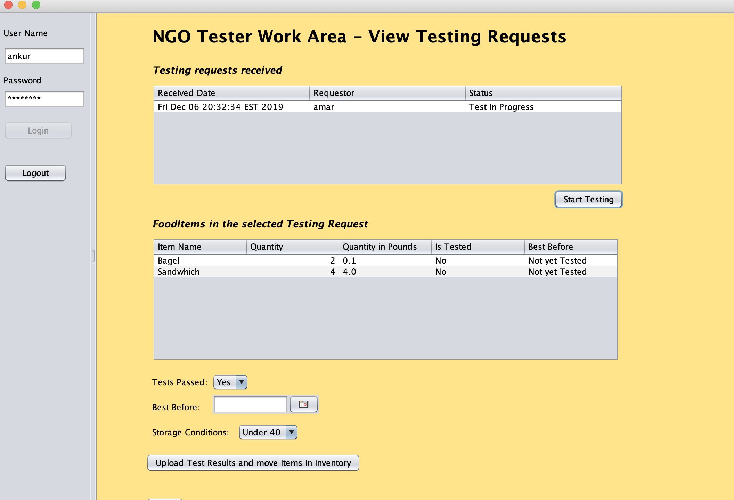

Slide 15
Use Case 5 – Distribution of Food Items
After the testing is completed, items are moved to edible or waste inventory based on their test results
Ngo staff checks the edible inventory and also the expiry date on the parcel before distributing the food items
If the items have expired, they are moved to waste inventory else they are distributed to hungry people
Ngo staff also inputs number of people fed

Slide 16
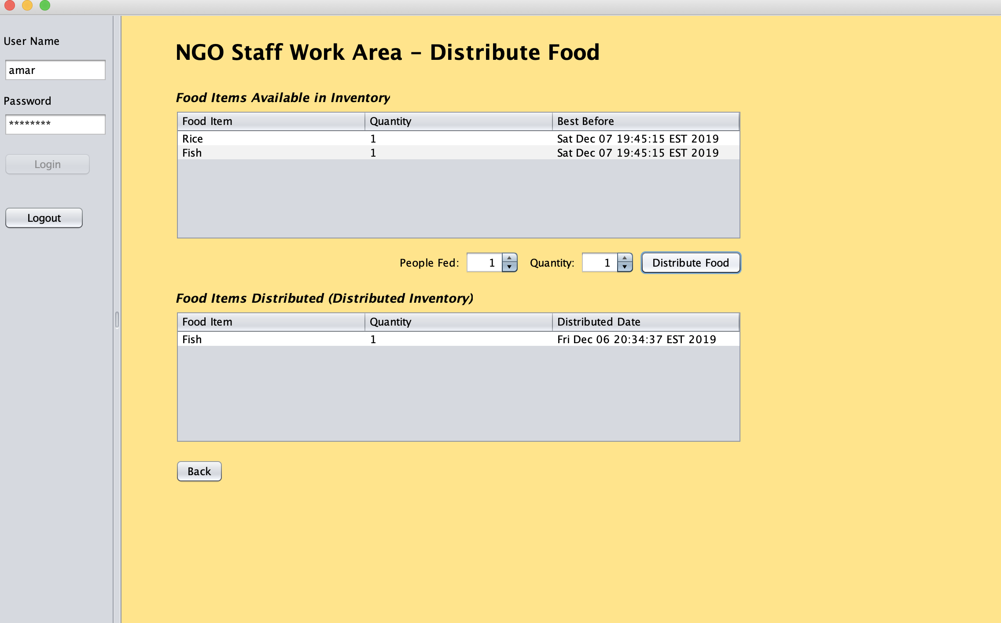

Slide 17
Use Case 6 – Billing Request
When Delivery Staff finishes the delivery of food items, they also mention the delivery cost and raise a bill
Delivery manager checks the bill and raises invoice with NGO
NGO Manager checks the invoice raised and settles the bill.

Slide 18
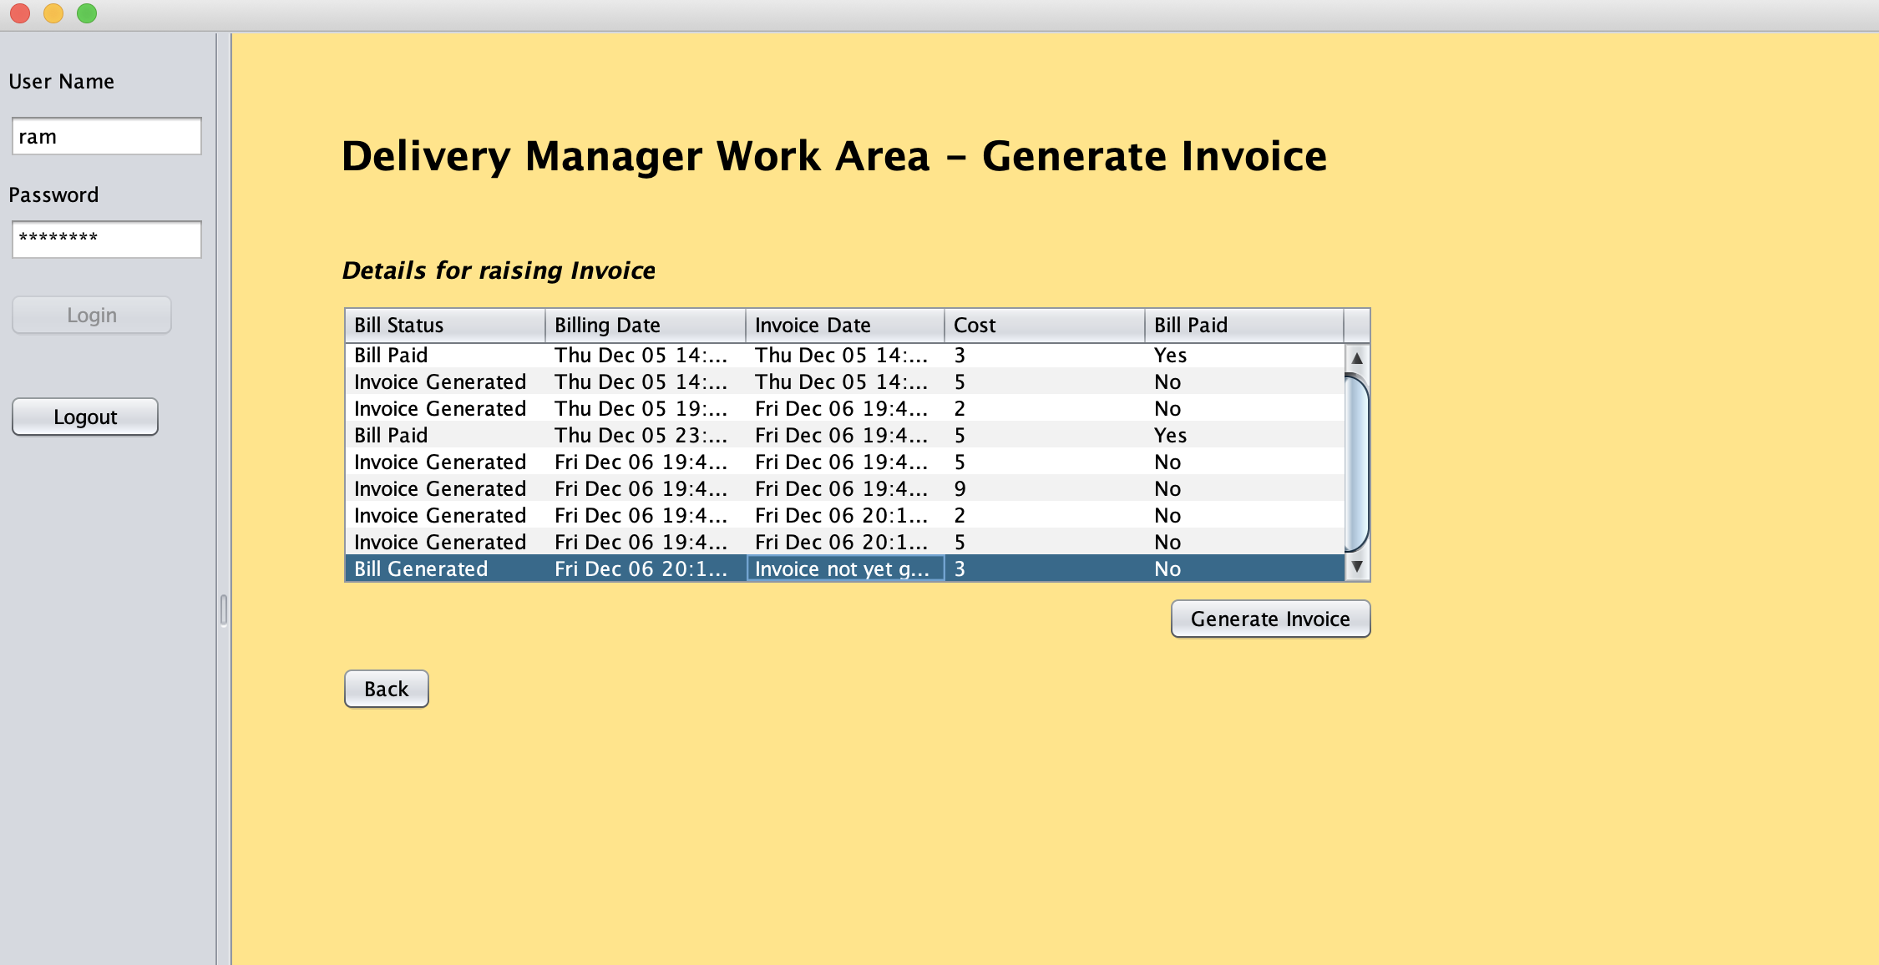

Slide 19
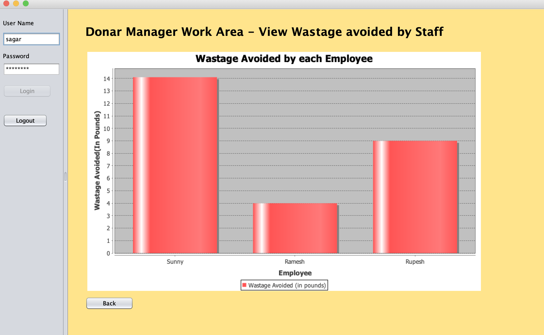

Slide 20
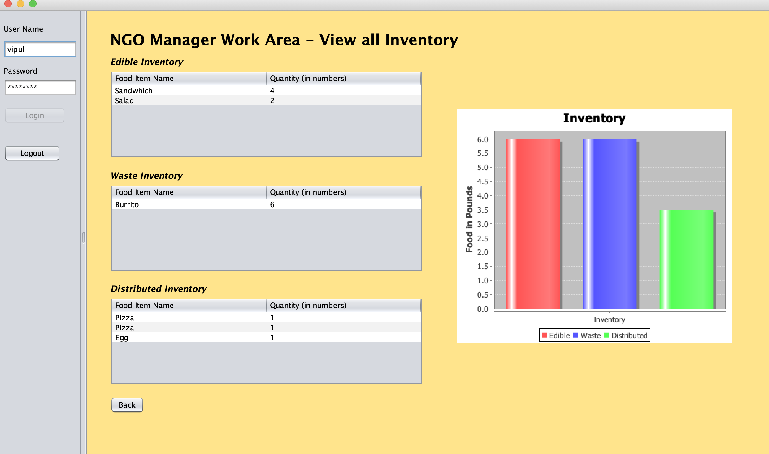

Slide 21
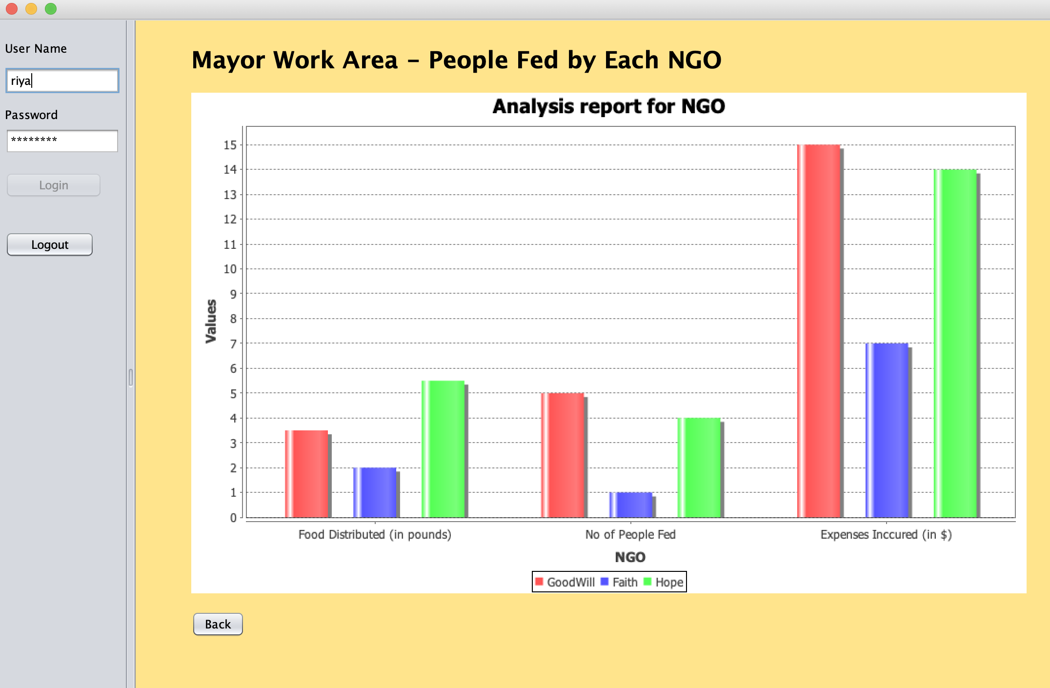

Slide 22
